Slide 1
Applied Natural Language Processing
Dr. Sucharitha Shetty

Slide 2
Table of Contents
Terminologies
Text Normalization
Word Tokenization
Word Normalization, Lemmatization and Stemming
Coding Time

Slide 3
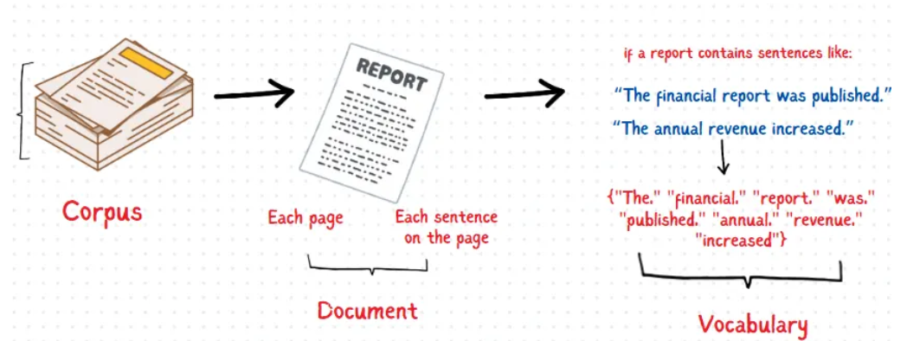
Terminologies
Imagine you’re analyzing monthly financial reports for your company.

Slide 4
Corpus
In NLP, a corpus is a collection of text that we use for analysis. Think of it as the entire body of text you’re working with.
In the example, if you have fifty reports, all these reports combined make up your corpus.

Slide 5
Documents
Each report or paragraph in your corpus is referred to as a document. A document represents a self-contained unit of information within the corpus.
Example:
Report 1: “Revenue increased by 10% in January compared to December. The marketing campaign contributed significantly to this growth.”
Report 2: “February saw a slight decline of 5% in expenditure. The main reason was reduced spending on operational costs.”
Here, each report is considered a separate document because it conveys a complete, meaningful set of information.

Slide 6
Documents
Sentences as Documents
In some cases, each sentence in your text can be treated as a separate document, especially when analyzing smaller chunks of information.
Example: Let’s take Report 1 and split it into sentences:
Sentence 1: “Revenue increased by 10% in January compared to December.”
Sentence 2: “The marketing campaign contributed significantly to this growth.”
Here, each sentence is treated as its own document.

Slide 7
Vocabulary
Vocabulary refers to the set of unique words present in your corpus. Think of it as a list of all the distinct words in your text without duplicates.
Example:
Sentence 1: The dog and cat are cute.
Sentence 2: The dog is cute.
Vocabulary: {“The”, “dog”, “and”, “cat”, “are”, “cute”, “is”}

Slide 8
WORDS
Words are the individual tokens or terms in your corpus. These are the building blocks of the vocabulary.
“He stepped out into the hall, was delighted to encounter a water brother”.
This sentence has 13 words if we don’t count punctuation marks as words, 15 if we count punctuation.
Whether we treat period (“.”), comma (“,”), and so on as words depends on the task.
Punctuation is critical for finding boundaries of things (commas, periods, colons) and for identifying some aspects of meaning

Slide 9
Recap of Terminologies
Corpus: All financial reports combined.
Documents: Each report or paragraph in the corpus.
Vocabulary: The set of unique words across all documents.
Words: Individual terms used in each document.

Slide 10
Text Normalization
Before almost any natural language processing of a text, the text has to be normalized.
At least three tasks are commonly applied as part of any normalization process:
Tokenizing (segmenting) words
Normalizing word formats
Segmenting sentences

Slide 11
Word Tokenization
The task of segmenting running text into words
Often need to break off punctuation as a separate token;
commas are a useful piece of information for parsers, periods help indicate sentence boundaries
But often want to keep the punctuation that occurs word internally, in examples like m.p.h., Ph.D., AT&T.
Special characters and numbers will need to be kept in prices ($45.55) and dates (01/02/06);
don’t want to segment that price into separate tokens of “45” and “55”.
And there are URLs (http://www.stanford.edu), Twitter hashtags (#nlproc), or email addresses (someone@cs.colorado.edu).

Slide 12
Word Normalization, Lemmatization and Stemming
Word normalization is the task of putting words/tokens in a standard format, choosing a single normal form for words with multiple forms Example: USA and US or uh-huh and uhhuh.
Disadvantage: The spelling information is lost in the normalization process. (but still useful in many applications)

Slide 13
Case folding
Case folding is a kind of normalization.
Mapping everything to lower case means that Woodchuck and woodchuck are represented identically, which is very helpful for generalization in many tasks, such as information retrieval or speech recognition.
For sentiment analysis and other text classification tasks, information extraction and machine translation, by contrast, case can be helpful and case folding is generally not done.
This is because maintaining the difference between, for example, US the country and us the pronoun can outweigh the advantage in generalization that case folding would have provided for other words.

Slide 14
Case folding
Example text normalization
Input: “The quick BROWN Fox Jumps OVER the lazy dog.”
Output: “the quick brown fox jumps over the lazy dog.”
Advantages
It eliminates case sensitivity, making text data consistent and easier to process.
It reduces the dimensionality of the data, which can improve the performance of NLP algorithms.
Disadvantages
It can lead to loss of information, as capitalization can indicate proper nouns or emphasis.

Slide 15
Punctuation Removal
Punctuation removal is the process of removing special characters and punctuation marks from the text. This technique is useful when working with text data containing many punctuation marks, which can make the text harder to process.
Example text normalization
Input: “The quick BROWN Fox Jumps OVER the lazy dog!!!”
Output: “The quick BROWN Fox Jumps OVER the lazy dog”
Advantages
It removes unnecessary characters, making the text cleaner and easier to process.
It reduces the dimensionality of the data, which can improve the performance of NLP algorithms.
Disadvantages
It can lead to loss of information, as punctuation marks can indicate sentiment or emphasis.

Slide 16
Stop Word Removal
Stop word removal is the process of removing common words with little meaning, such as “the” and “a”. This technique is useful when working with text data containing many stop words, which can make the text harder to process.
Example text normalization
Input: “The quick BROWN Fox Jumps OVER the lazy dog.”
Output: “quick BROWN Fox Jumps OVER lazy dog.”
Advantages
It removes unnecessary words, making the text cleaner and easier to process.
It reduces the dimensionality of the data, which can improve the performance of NLP algorithms.
Disadvantages
It can lead to loss of information, as stop words can indicate context or sentiment.

Slide 17
Removing numbers and symbol to normalize the text in NLP
This technique is useful when working with text data that contain numbers and symbols that are not important for the NLP task.
Example text normalization
Input: “I have 2 apples and 1 orange #fruits”
Output: “I have apples and orange fruits”
Advantages
It removes unnecessary numbers and symbols, making the text cleaner and easier to process.
It reduces the dimensionality of the data, which can improve the performance of NLP algorithms.
Disadvantages
It can lead to loss of information, as numbers and symbols can indicate quantities or sentiments.

Slide 18
Removing any remaining non-textual elements to normalize the text in NLP
Removing any remaining non-textual elements such as HTML tags, URLs, and email addresses This technique is useful when working with text data that contains non-textual elements such as HTML tags, URLs, and email addresses that are not important for the NLP task.
Example text normalization
Input: “Please visit <a href=’www.example.com‘>example.com</a> for more information or contact me at info@example.com”
Output: “Please visit for more information or contact me at “
Advantages
It removes unnecessary non-textual elements, making the text cleaner and easier to process.
It reduces the dimensionality of the data, which can improve the performance of NLP algorithms.
Disadvantages
It can lead to loss of information, as non-textual elements can indicate context or sentiment.

Slide 19
Removing any remaining non-textual elements to normalize the text in NLP
Removing any remaining non-textual elements such as HTML tags, URLs, and email addresses This technique is useful when working with text data that contains non-textual elements such as HTML tags, URLs, and email addresses that are not important for the NLP task.
Example text normalization
Input: “Please visit <a href=’www.example.com‘>example.com</a> for more information or contact me at info@example.com”
Output: “Please visit for more information or contact me at “
Advantages
It removes unnecessary non-textual elements, making the text cleaner and easier to process.
It reduces the dimensionality of the data, which can improve the performance of NLP algorithms.
Disadvantages
It can lead to loss of information, as non-textual elements can indicate context or sentiment.

Slide 20
Stemming
Stemming:
In information retrieval and web search (IR), we might want to map from foxes to fox;
but might not need to also know that foxes is plural.
Just stripping off such word endings is called stemming in IR.
Porter stemmer : a simple stemming algorithm.

Slide 21
Stemming reduces the words to their root form by removing suffixes and prefixes, such as “running” will be “run”. This method is helpful when working with text data that has many different versions of the same word, which can make the text harder to process.
Example text normalization
Input: “running, runner, ran, caress”
Output: “run, run, run, car”
Advantages
It reduces the dimensionality of the data, which can improve the performance of NLP algorithms.
It makes it easier to identify the core meaning of a word.
Disadvantages
It can lead to loss of information, as the root form of a word may not always be the correct form.
It may produce non-existent words

Slide 22
Lemmatization
For other speech and language processing tasks, we need to know that two words have a similar root, despite their surface differences.
For example the words sang, sung, and sings are all forms of the verb sing.
The word sing is called the common lemma of these words, and mapping from all of these to sing is called lemmatization

Slide 23
Lemmatization
Lemmatization is the task of determining that two words have the same root, despite their surface differences.
Lemmatization reduces words to their base form by considering the context in which they are used, such as “running” will become “run”.
The words dinner and dinners both have the lemma dinner
The most sophisticated methods for lemmatization involve complete morphological parsing of the word
Notes:
17

Slide 24
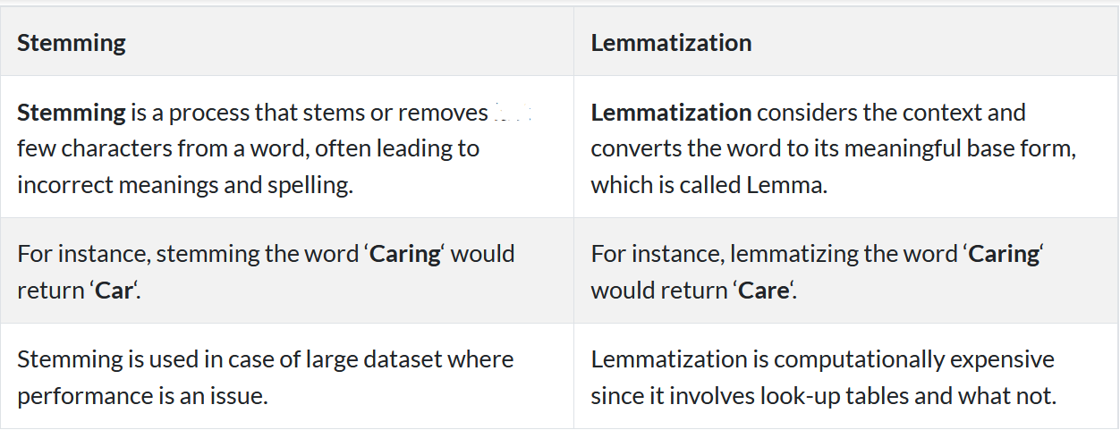
Notes:
18

Slide 25
Coding Time
Notes:
23

Slide 26
Table of Contents
Bag-of-Words
TF-IDF
Coding Time

Slide 27
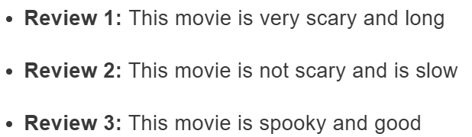
Bag of Words
The Bag of Words (BoW) model is the simplest form of text representation in numbers.
Example:
We will first build a vocabulary from all the unique words in the above three reviews. The vocabulary consists of these 11 words: ‘This’, ‘movie’, ‘is’, ‘very’, ‘scary’, ‘and’, ‘long’, ‘not’, ‘slow’, ‘spooky’, ‘good’.
Notes:
18

Slide 28
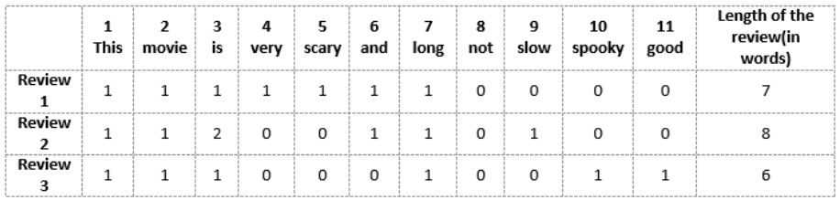
Vector-of-Review1: [1 1 1 1 1 1 1 0 0 0 0]
Vector-of-Review2: [1 1 2 0 0 1 1 0 1 0 0]
Vector-of-Review3: [1 1 1 0 0 0 1 0 0 1 1]
Bag of Words
We can now take each of these words and mark their occurrence in the three movie reviews above with 1s and 0s. This will give us 3 vectors for 3 reviews:
Vector-of-Review1: [1 1 1 1 1 1 1 0 0 0 0]
Vector-of-Review2: [1 1 2 0 0 1 1 0 1 0 0]
Vector-of-Review3: [1 1 1 0 0 0 1 0 0 1 1]
Notes:
27

Slide 29
Drawbacks of using a Bag-of-Words (BoW) Model
If the new sentences contain new words, then our vocabulary size would increase and thereby, the length of the vectors would increase too.
Additionally, the vectors would also contain many 0s, thereby resulting in a sparse matrix (which is what we would like to avoid)
We are retaining no information on the grammar of the sentences nor on the ordering of the words in the text.
Notes:
28

Slide 30
Coding Time
Notes:
23

Slide 31
Thank You

